Slide 1

Lifestyle Disease Risk
Prediction System
Presented by : Jibi Mol K A

Slide 2

Introduction
Lifestyle diseases such as Diabetes, Heart Disease, and Stroke are primarily caused by unhealthy habits including poor diet, lack of physical activity, smoking, and alcohol consumption.
With the growth of machine learning and data analytics, it is possible to predict disease risks
at an early stage.
This project focuses on using machine learning models to analyze lifestyle and health-related data and predict the risk of lifestyle diseases among different age groups, enabling early awareness and preventive care.

Slide 3
Objectives of the Study
To categorize the population into different age groups for disease risk analysis
To analyze the probability of lifestyle diseases such as Diabetes, Stroke, and Heart Disease
across each age group.
To identify the key lifestyle and health parameters contributing to each disease.
To calculate the percentage distribution of disease risk within different age categories.

Slide 4
Design of System
PURPOSE : To analyze age group–wise disease risk and predict the probability of lifestyle diseases such as Diabetes,
Heart Disease, and Stroke using machine learning techniques.
FRONTEND : Developed using Gradio, it provides a simple and interactive web-based interface that allows user to input
health and lifestyle details.
USER INPUTS : Age, Sex, Hypertension, Heart Disease, BMI, HbA1c Level, Blood Glucose Level, Resting blood Pressure,
Cholesterol, Max Heart Rate.
BACKEND ML MODEL : Trained using Random Forest Classifier and used processed health data.
OUTPUT :
Predicted disease risk for Diabetes, Stroke and Heart Disease.
Percentage probability of each disease across age groups.
Key contributing parameters for each disease.

Slide 5
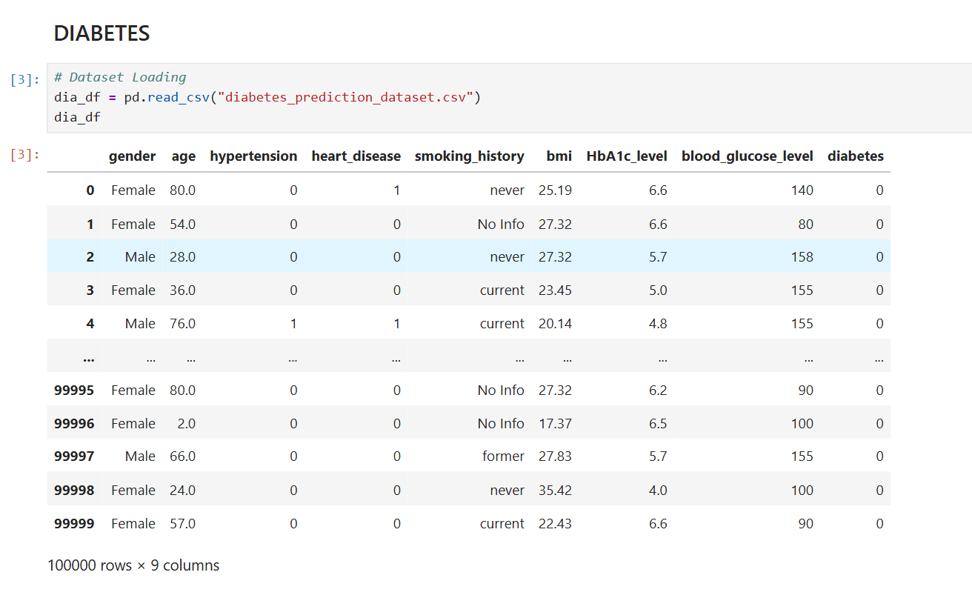
Datasets

Slide 6
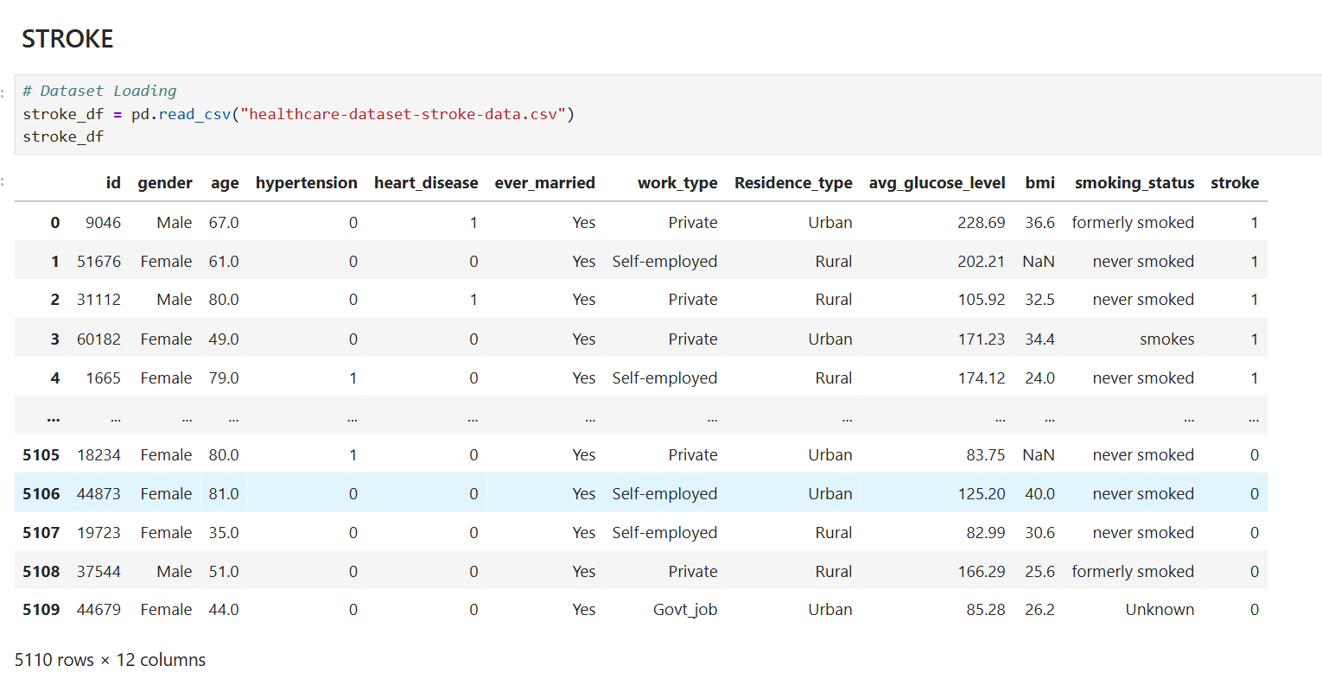
Datasets

Slide 7
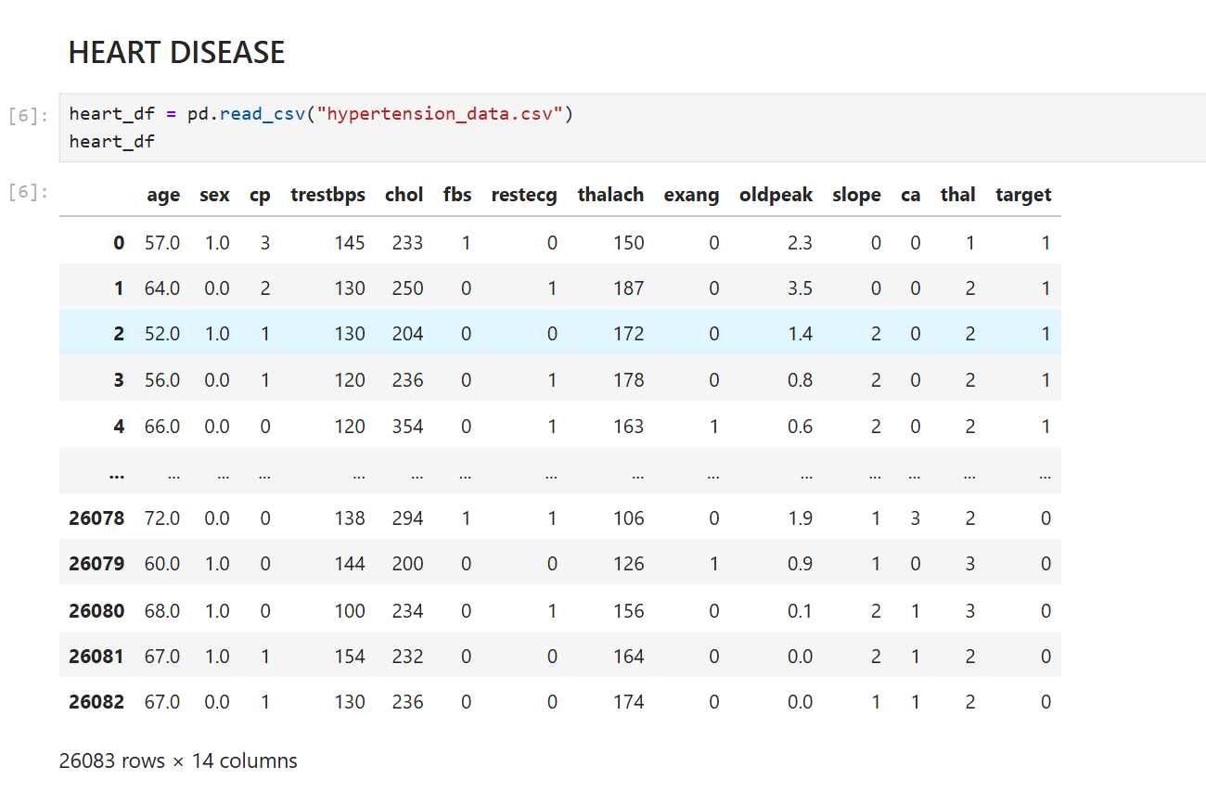
Datasets

Slide 8
Process on dataset
Data Collection
Data Cleaning
Data Preprocessing
Disease Prediction
&
Age group analysis
Model Training
Feature Selection

Slide 9
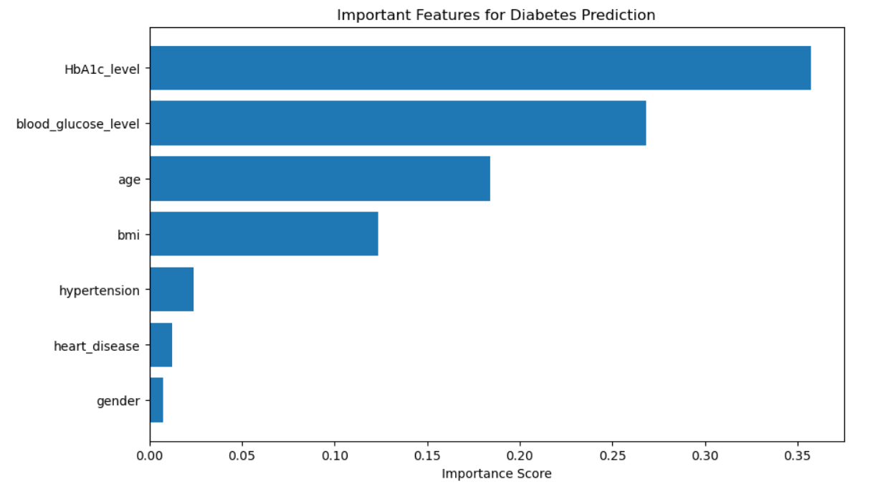
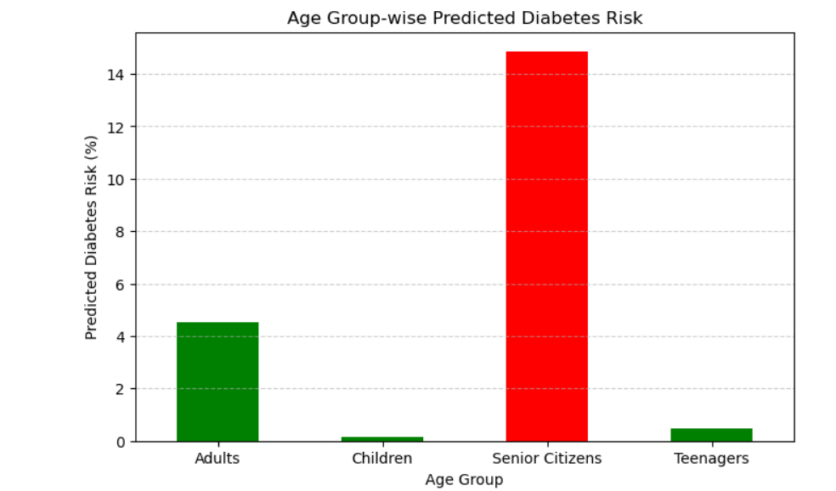
Graphical Overview
Analysis of Diabetes Risk Across Age Groups and Parameters

Slide 10
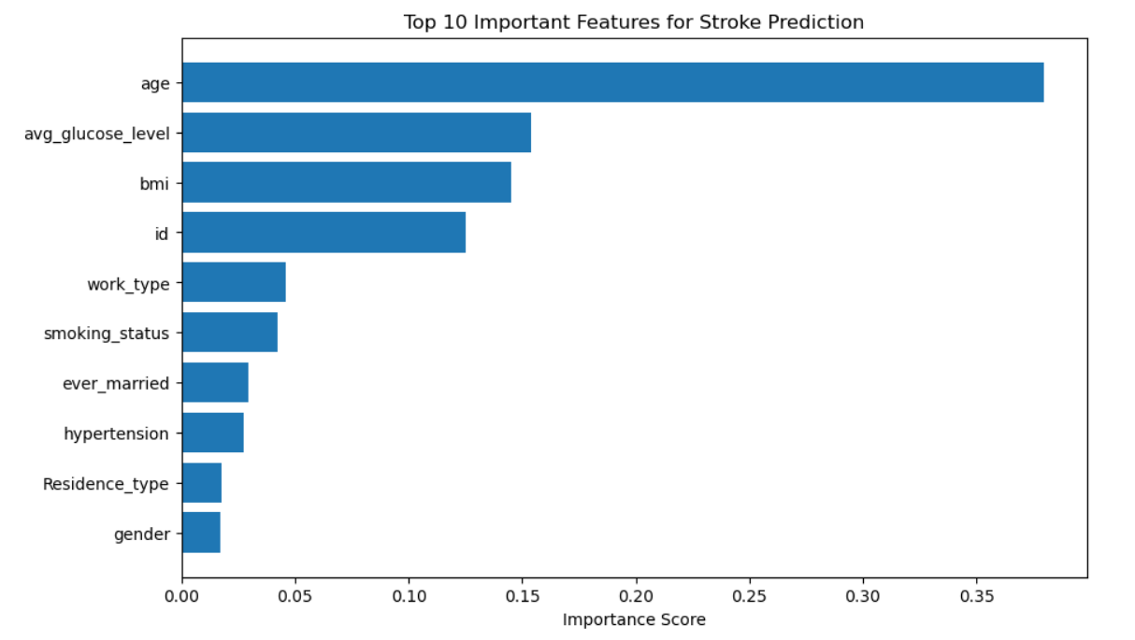
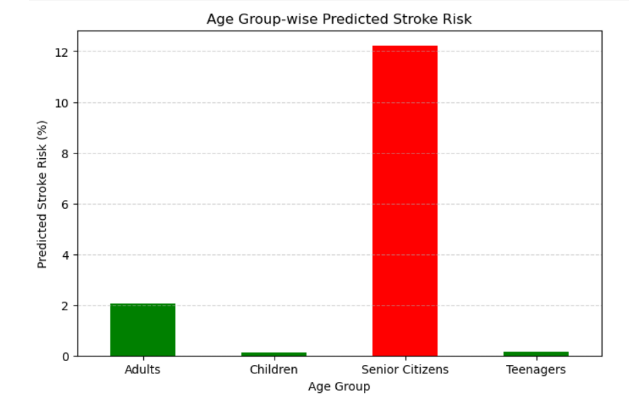
Graphical Overview
Analysis of Stroke Risk Across Age Groups and Parameters

Slide 11
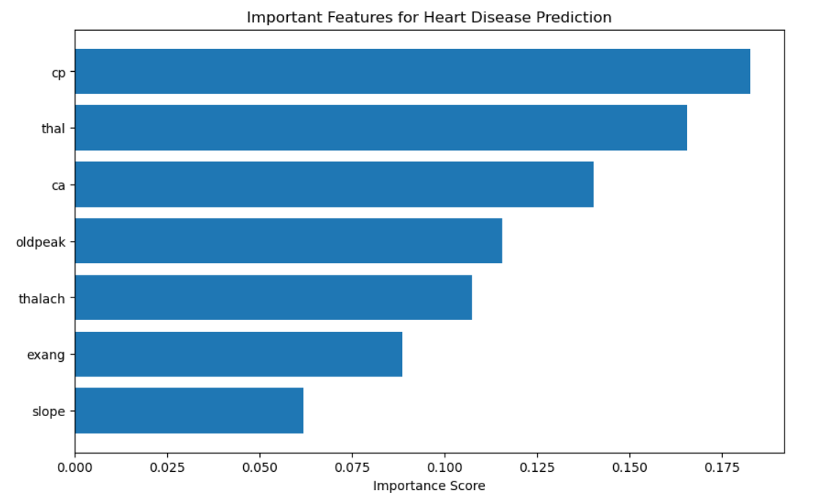
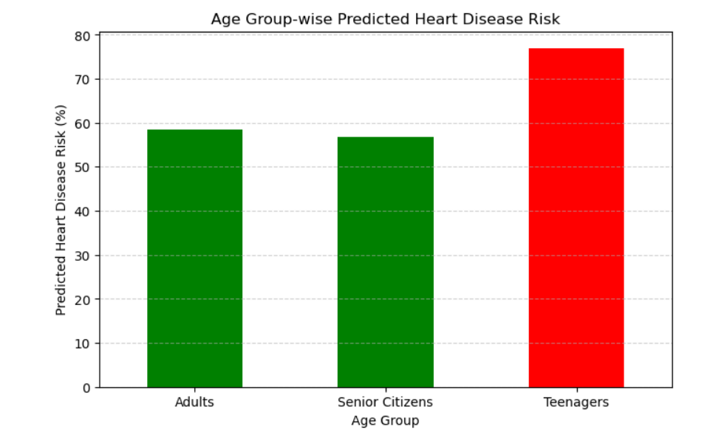
Graphical Overview
Analysis of Heart Disease Risk Across Age Groups and Parameters

Slide 12
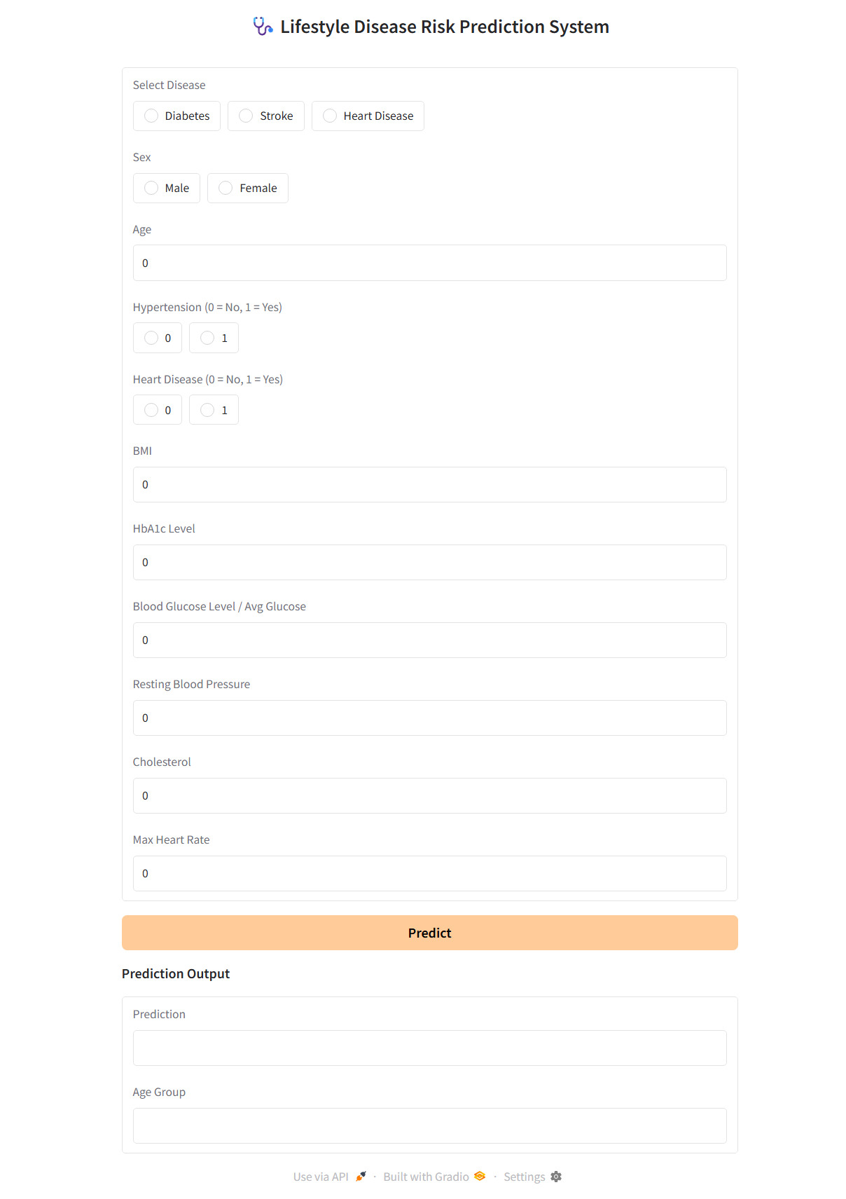
User Interface

Slide 13
Conclusion
The project demonstrates the effective use of ML techniques to predict the risk of lifestyle diseases
such as Diabetes, Stroke, and Heart Disease by performing age group–wise analysis.
From the results, senior citizens show the highest risk for both diabetes and stroke, indicating that these diseases are more relevant in older age groups.
In contrast, heart disease risk is observed comparatively higher among teenagers and adults based
on the model predictions. Chidrens consistently show minimal risk across all three diseases.
The Random Forest model effectively identifies key health and lifestyle parameters influencing
each disease.
Overall, the system provides valuable insights into age-based disease risk patterns and supports early awareness and preventive healthcare planning.

Slide 14
Future Scope
Deployment as a web or mobile application for wider public accessibility.
Enhancement of model performance using advanced machine learning and deep learning techniques.
Integration with real-time health data from wearable devices and medical sensors.
Expansion of the system to predict more lifestyle-related diseases.

Slide 15
References
Diabetes Prediction Dataset – Kaggle
URL: https://www.kaggle.com/datasets/iammustafatz/diabetes-prediction-dataset
Stroke Prediction Dataset – Kaggle
URL:https://www.kaggle.com/datasets/fedesoriano/stroke-prediction-dataset
Heart Disease Dataset – Kaggle
URL:https://www.kaggle.com/datasets/prosperchuks/health-dataset

Slide 16
Thank You !

